Slide 1
Don't Write Secure Code! (Build secure systems instead)
Seth Petry-Johnson @spetryjohnson

Slide 2
I hate writing secure code

Slide 3
I hate writing secure code I hate writing secure features

Slide 4
I hate writing secure code I hate writing secure features I hate implementing cross-cutting security concerns by repeating the same patterns over and over again in my feature-level code

Slide 5
What's on the agenda?
Define "cross cutting" security concerns
<x> real-world examples (.NET and JS)
???

Slide 6
"Cross cutting" concern
Any security requirement that
spans multiple features

Slide 7

"Cross cutting" concerns
Security Requirements:
User must be logged in
Users with the "Manage Orders" permission see all Orders
Everyone else sees only their own Orders

Slide 8
"Cross cutting" concerns
Security Requirements:
User must be logged in
Users with the "Manage Orders" permission see all Orders
Everyone else sees only their own Orders

Slide 9
"Cross cutting" concerns

Slide 10
"Cross cutting" concerns

Slide 11
"Cross cutting" concerns

Slide 12
"Cross cutting" concerns

Slide 13
"Cross cutting" concerns

Slide 14
Show me the codez!

Slide 15
Goals for framework-level security code
"Secure by default"
Consistent implementation
Easy to audit

Slide 16
Patented step-by-step slide
Old news
New hotness

Slide 17
Canonical example: SQL Injection

Slide 18
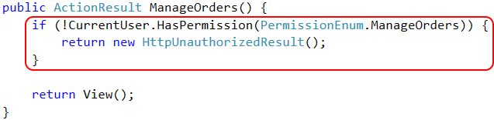
Authorization - feature

Slide 19

Authorization - framework

Slide 20
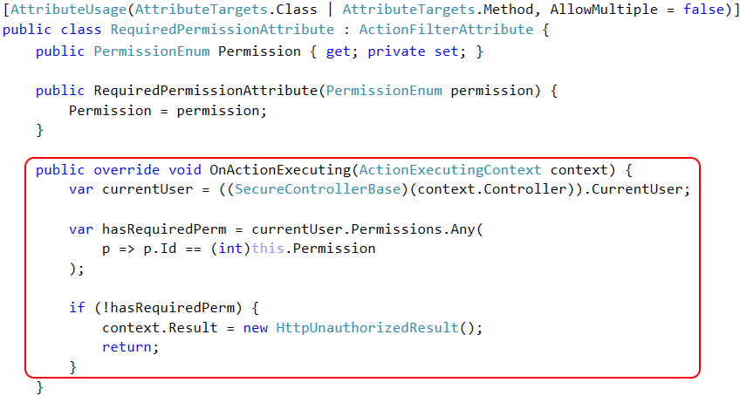

Slide 21
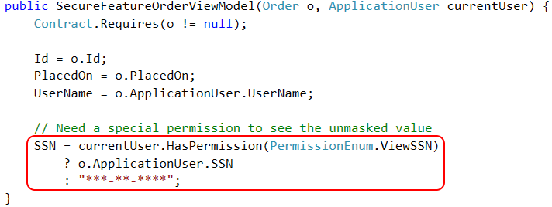
Authorization - feature

Slide 22
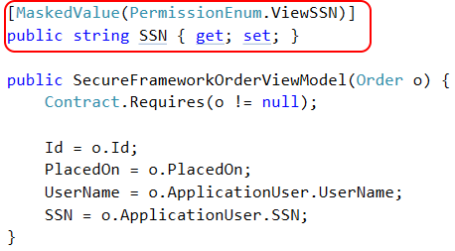
Authorization - framework

Slide 23
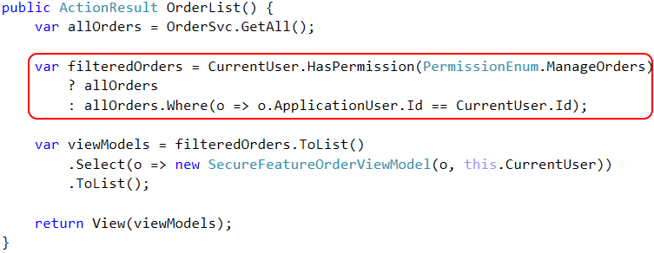
Access Control - feature

Slide 24
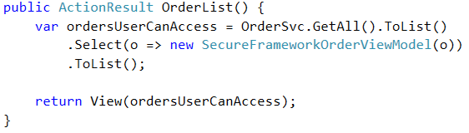
Access Control - framework

Slide 25
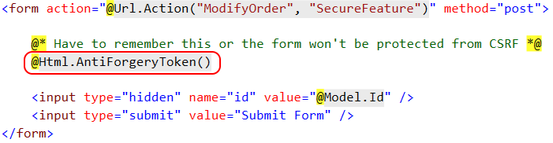
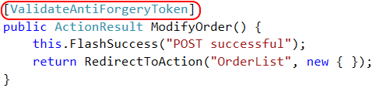
CSRF Defense - feature

Slide 26

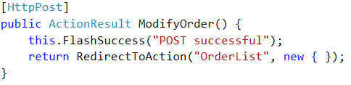
CSRF Defense - framework

Slide 27
Closing slide
The knowledge gets dropped here
github.com/spetryjohnson | www.petry-johnson.com
@spetryjohnson

